Slide 1
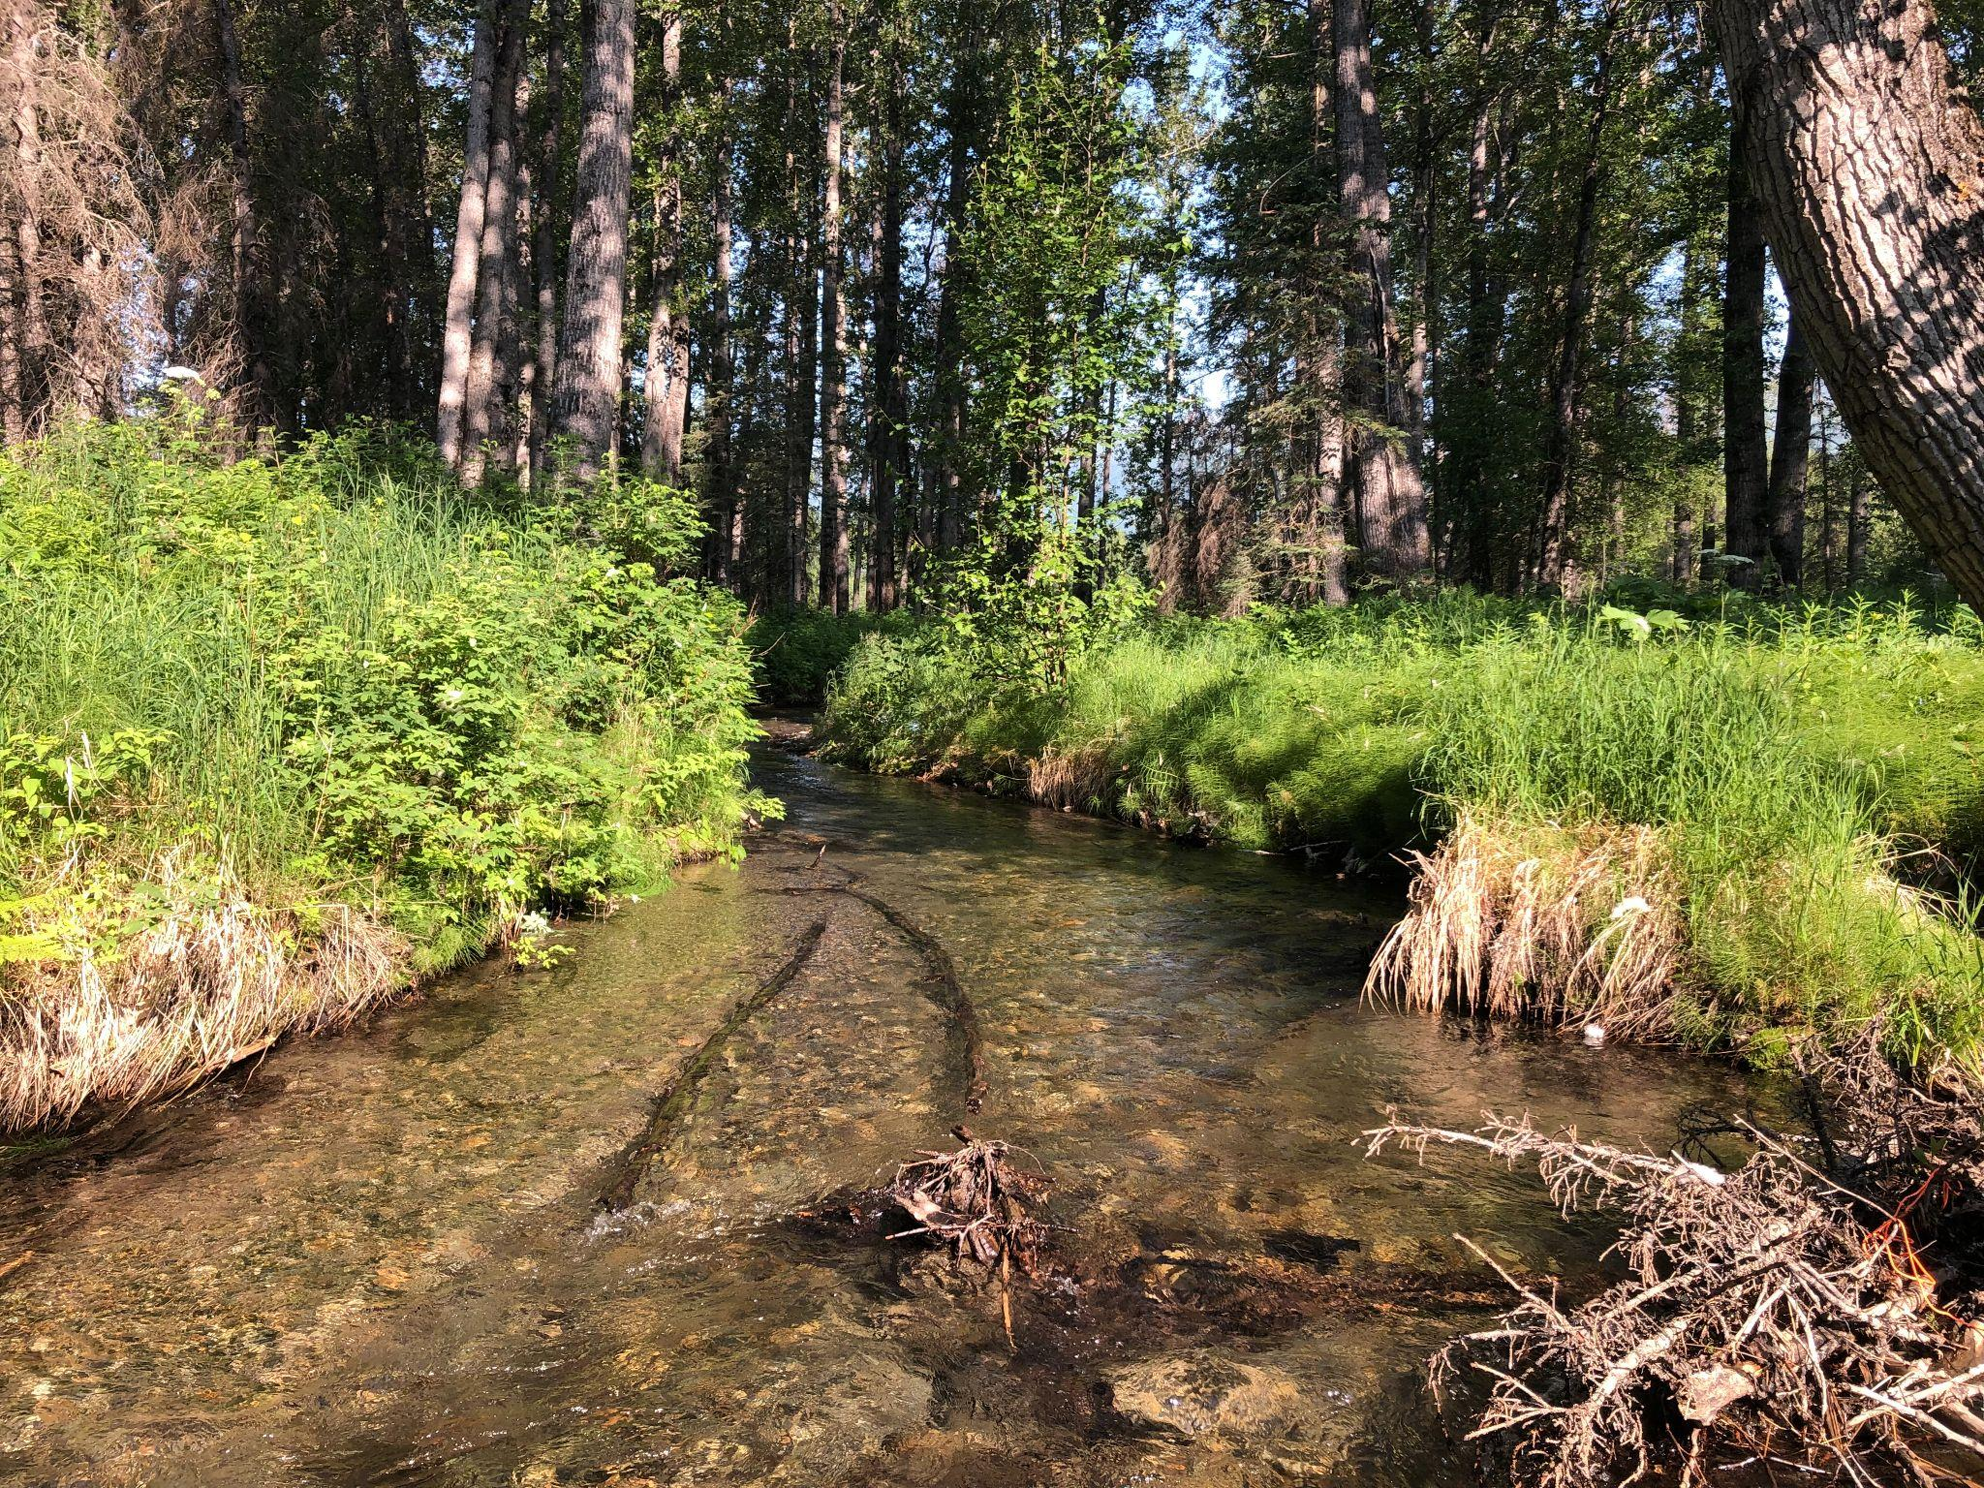
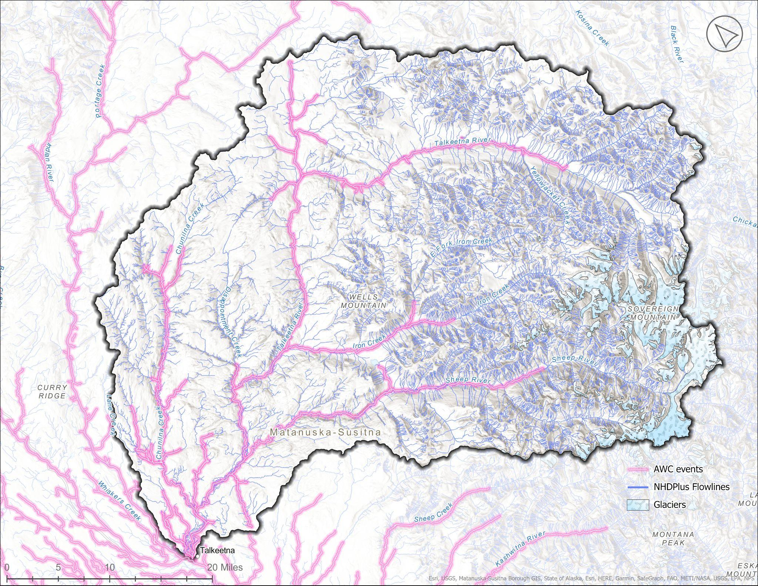

Mat-Su Anadromous Waters Prioritization
Basin Name | NHDPlus (km) | AWC (km) | AWC (%)
Matanuska | 15,300 | 401 | 3%
Upper Susitna River | 14,530 | 473 | 3%
Talkeetna River | 10,459 | 461 | 4%
Chulitna River | 8,723 | 587 | 7%
Yentna River | 23,217 | 2,419 | 10%
Anchorage | 3,106 | 582 | 19%
Lower Susitna River | 11,745 | 3,032 | 26%
Mat-Su Salmon Symposium Tidbit
Nov. 14 & 15, 2022
Rebecca Shaftel
rsshaftel@alaska.edu

Slide 2
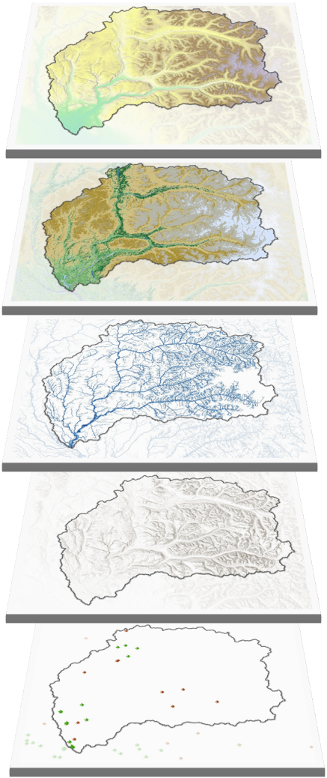
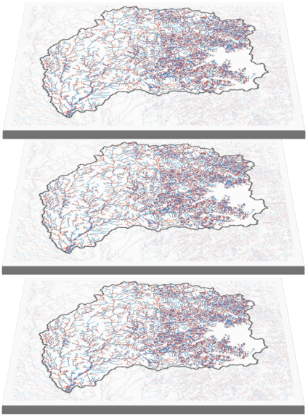
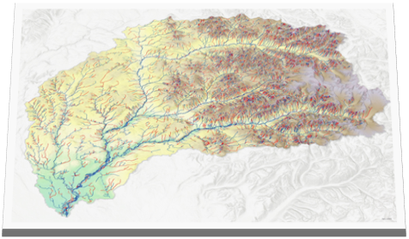
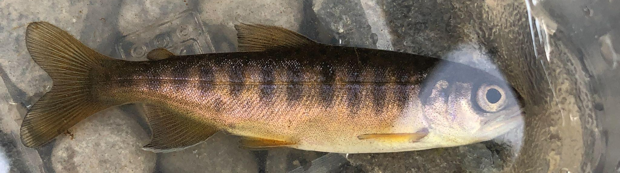
Ensemble Modeling of Juvenile Salmon Habitat
Final Predictions on
Stream Network
Model 1
Model 2
Model 3
EnvironmentalDatasets
Fish Presence/
Absence Dataset
Mat-Su Salmon Symposium Tidbit
Nov. 14 & 15, 2022
Rebecca Shaftel
rsshaftel@alaska.edu

